Slide 1

GitHub

Slide 2
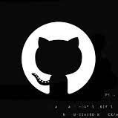
AGENDA
What is GitHub?
Need for GitHub
Why makes GitHub popular?
Getting started with GitHub
Create Repository
Create Branch
Make a Commit
OPEN & MERGE PULL REQUEST

Slide 3

What is GitHub?
Git pushes or pulls data from the central server
Web – based Git repository hosting service
Easy Management of code
Open – source software for Version control
Effective collaboration
Bug tracker

Slide 4

THE NEED FOR GITHUB
Developers need a web/cloud based code hosting platform
Useful for version control
Enables effective collaboration
Download projects and files in one go
Easy evaluation of each other’s work

Slide 5

But what makes GitHub so popular?
Immensely powerful community
The largest shared repository
Easy version control
Secure cloud storage

Slide 6
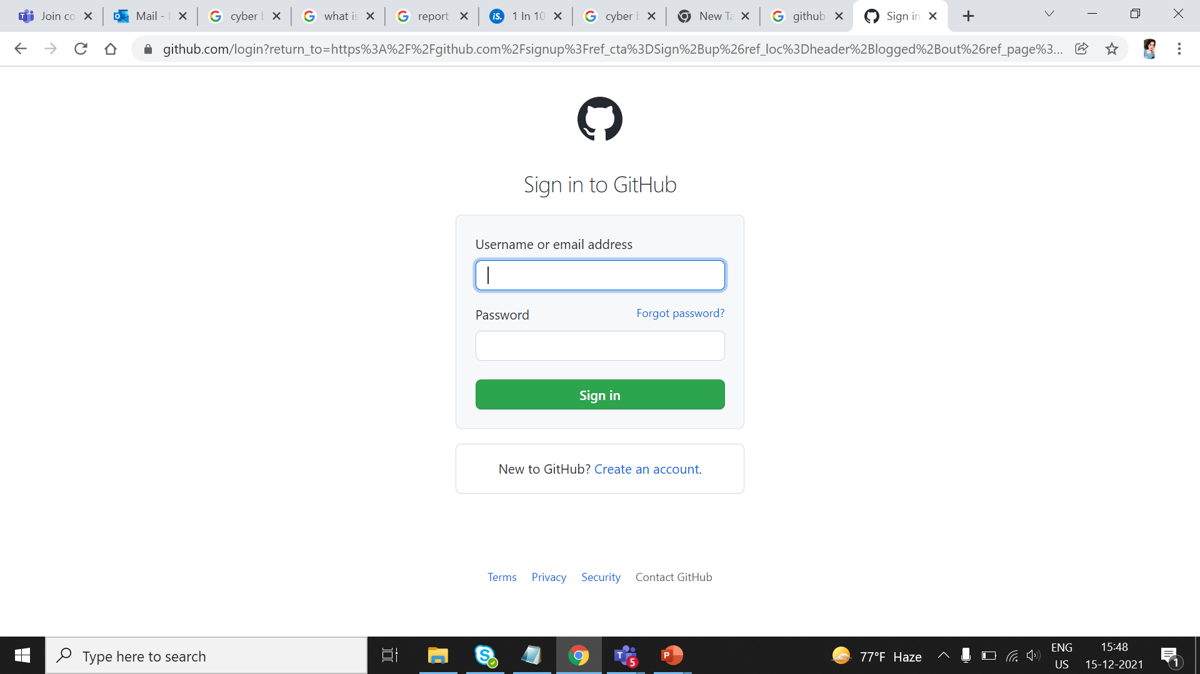
GitHub Sign In page

Slide 7
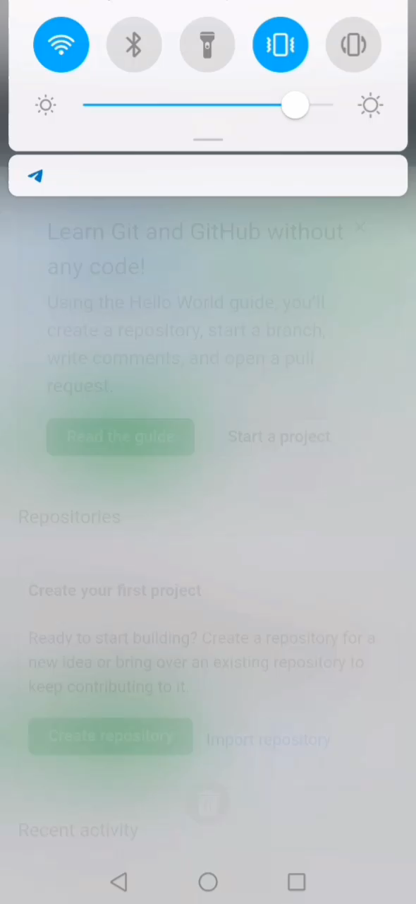
CREATE A REPOSITORY
Storage space for your project
GitHub is a very popular central repository that allows you to share your files
Push your local repo into GitHub and share it with other collaborators via the central repo

Slide 8
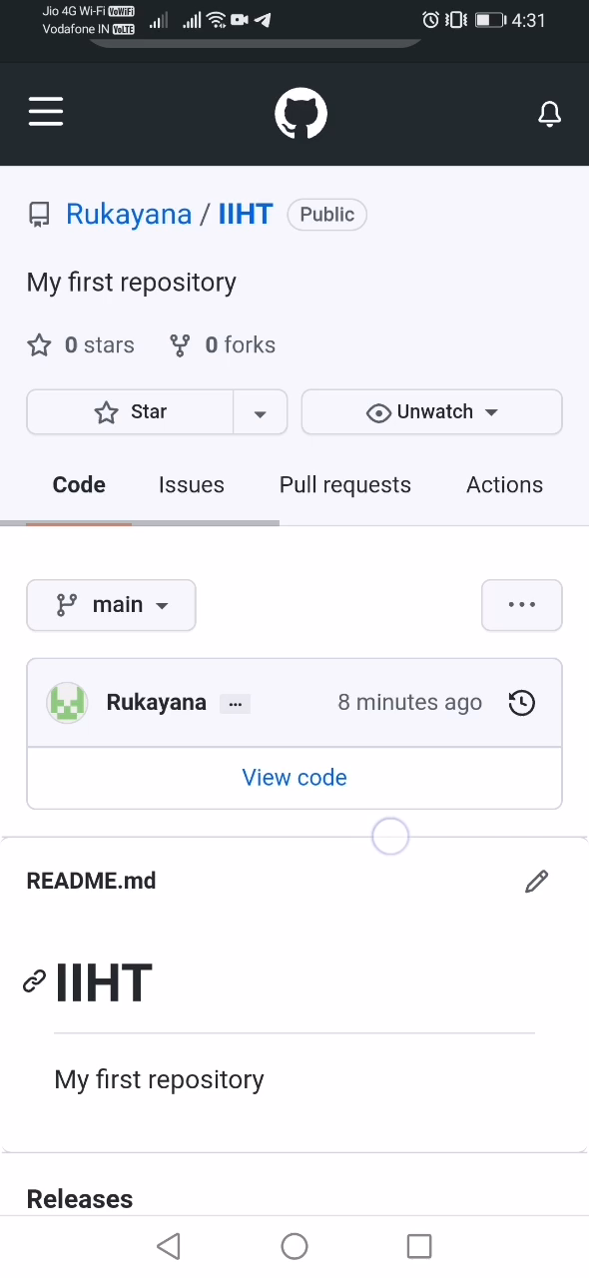
CREATE A BRANCH
Branches allows you to work on other features
They can be included with main line of your project
The main branch – the one where all changes eventually get merged back into , and is called master

Slide 9
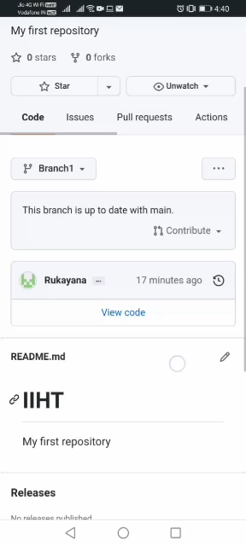
MAKE A COMMIT
Records changes to one or more files in your branch
Git assigns each commit a unique ID, called a SHA or hasg,that identifies : The specific changes

Slide 10
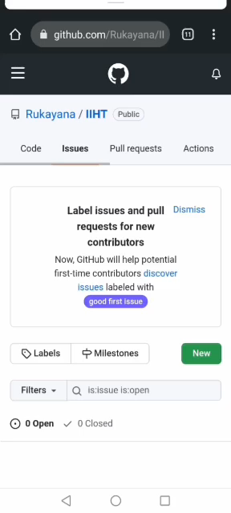
OPEN & MERGE PULL REQUEST
Notifies developer about changes you’ve pushed to a branch in a repository
Acknowledge and review changes
You can create a pull request on GitHub in 2 ways

Slide 11

CASE STUDY
Microsoft Corporation is an American multinational technology company
It develops , manufactures , licenses , supports , and sells computer software , consumer electronics , PCs , and related services
Initially , Microsoft were against the use of Open source
Held tightly to their IP
But after 2000 ,they are one of the biggest contributors to open source , which provides a way to manage thousands of repositories
Microsoft believes that GitHub’s value is not any one feature but its entire community

Slide 12

THANK YOU

